Slide 1
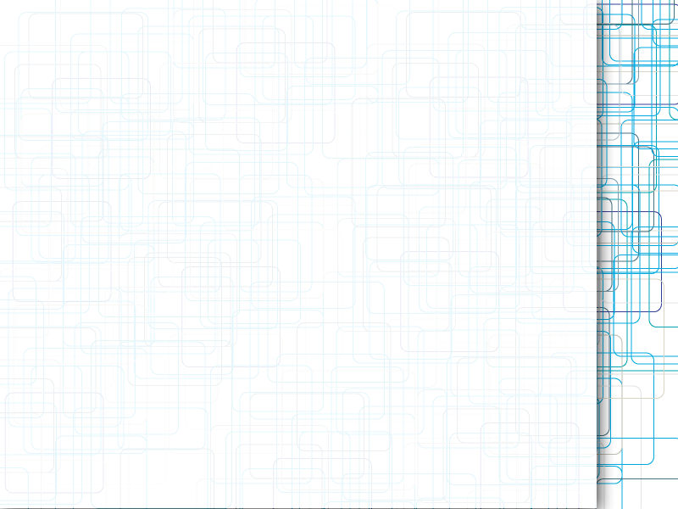
CalPlug EMS
Shivam Patel
Progress Update
6/13/12

Slide 2
Current Tasks
Inspect current probe
Learn Lab View

Slide 3
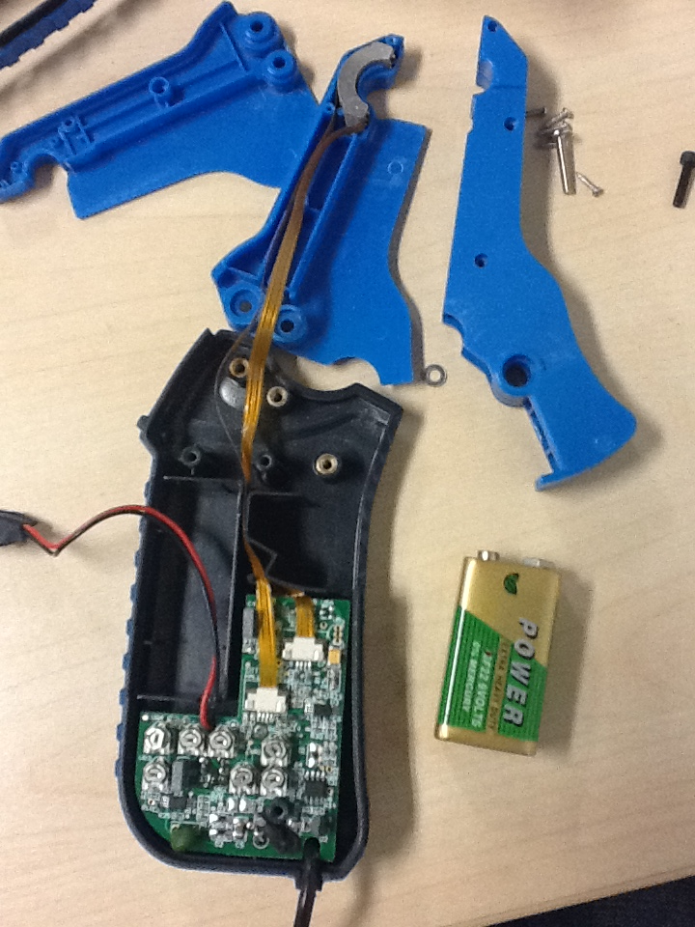
Current Probe Inspection
Chip is only about 4 square inches

Slide 4
Quarter Review
Learned functions of current probes
Practice with giving presentations and with soldering
Contributed in some ares of the overall project

